Slide 1
PORTFOLIO PRESENTATION
SS
Simphiwe
Sethole
Aspiring Data Engineer · BCom Information Systems
Practical skills. Purposeful projects. Continuous growth.
2026

Slide 2
01 / PROFILE
SIMPHIWE SETHOLE
Building toward data engineering
A practical foundation in information systems, software and collaborative problem-solving.
Education
BCom Information Systems at the University of Johannesburg · Expected 2027
Direction
Moving from coding fundamentals toward the systems that collect, organise and move data.
Approach
Learn hands-on, contribute ideas and work constructively with others under time pressure.

Slide 3
02 / CAPABILITIES
SIMPHIWE SETHOLE
A growing, practical toolkit
Technical capability supported by the habits that make teams work.
TECHNICAL
WAYS OF WORKING
HTML · CSS · JavaScript
SQL · C# foundations
Excel · Azure Data Fundamentals
Git & GitHub · Atlassian Jira
Problem-solving · Teamwork
Communication · Organisation
Time management · Adaptability
Idea development

Slide 4
03 / PROJECTS
SIMPHIWE SETHOLE
Three projects show breadth and application
Product development, decision modelling and Agile delivery each provide evidence of practical learning.
01
02
03
UJ Compass
Project Selection Dashboard
Community Food Rescue
Responsive student-support prototype built by a four-person team in a two-hour hackathon sprint.
Weighted Excel scoring model with automatic ranking, conditional formatting and a recommendation dashboard.
Jira-managed Agile workflow covering user stories, priorities, responsibilities and sprint progress.
HTML · CSS · JavaScript
Excel · Formulas · Visualisation
Jira · Agile/Scrum · Workflow

Slide 5
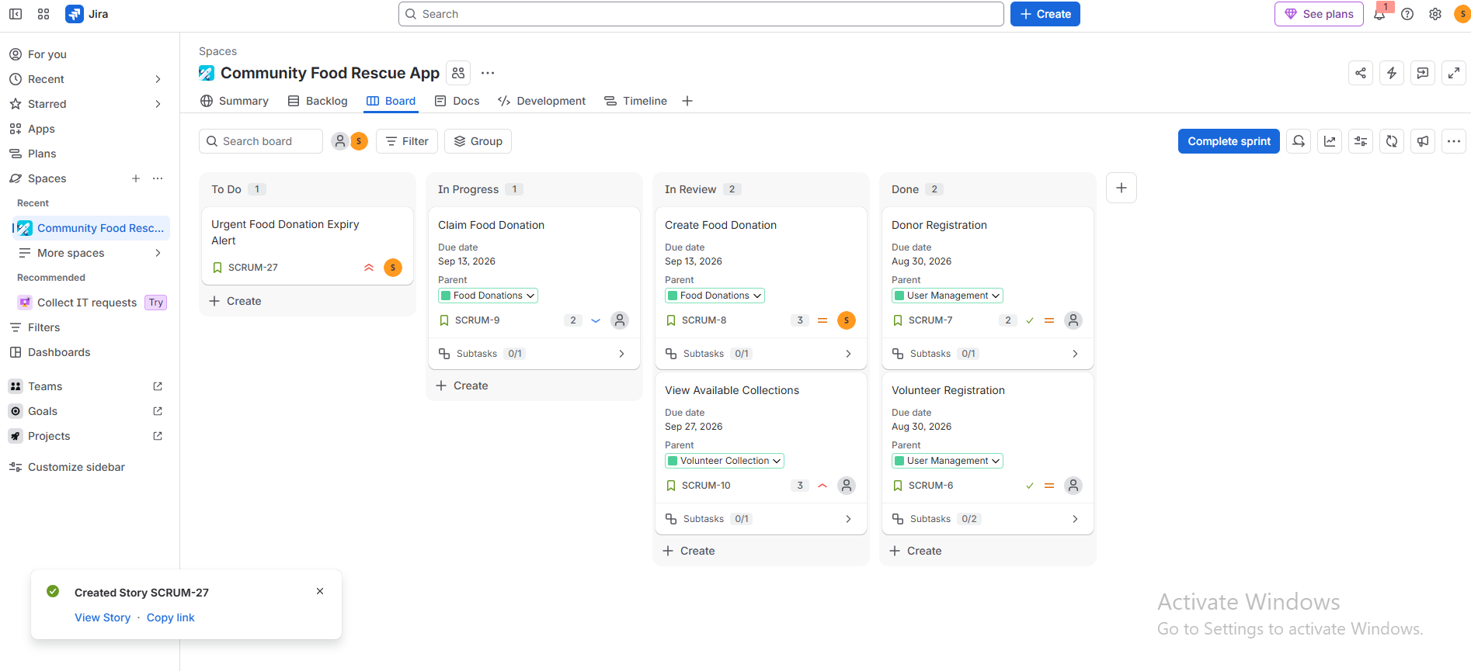
04 / JIRA EVIDENCE
SIMPHIWE SETHOLE
Agile work was managed through a visible workflow
The board demonstrates prioritisation, task ownership and progress across To Do, In Progress, In Review and Done.

Slide 6
05 / OPPORTUNITY
SIMPHIWE SETHOLE
Ready to learn, contribute
and keep building.
I am seeking internships and early-career opportunities where I can apply my information-systems foundation, deepen my data skills and contribute to useful technology.
simphiwesethole4@gmail.com
linkedin.com/in/simphiwe-sethole-292427427
github.com/Simphiwe0510IS
Johannesburg, South Africa

